Slide 1

When I had attained the age of seventeen
parents resolved that I should become a
at the university of Ingolstadt. My departure
therefore fixed at an early date, but before
day resolved upon could arrive, the first
of my life occurred. An omen, as it were, of
future misery.

Slide 2
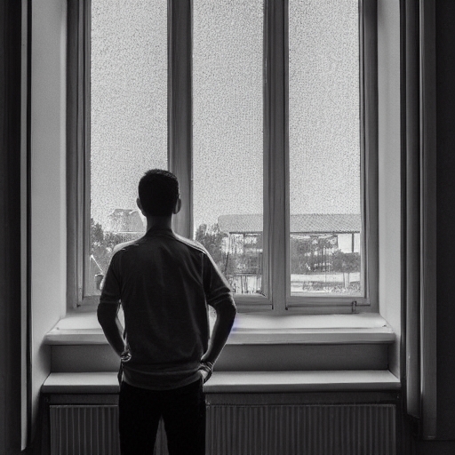
Grief is the most irreparable evil, the void that presents itself to the soul. Yet from whom has
that rude hand rent away some dear connection? The smile that plays upon the lips, although
may be deemed a sacrilege, is not banished.

Slide 3
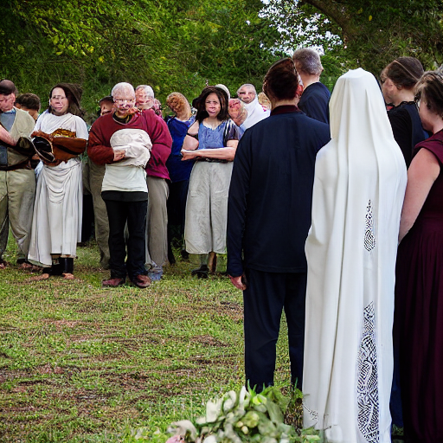
We sat late. We could not tear ourselves away from each other nor persuade ourselves to say
word ‘Farewell!’ It was said, and we retired under the pretence of seeking repose, each
that the other was deceived. But when at morning’s dawn I descended to the carriage which
to convey me away, they were all there.

Slide 4
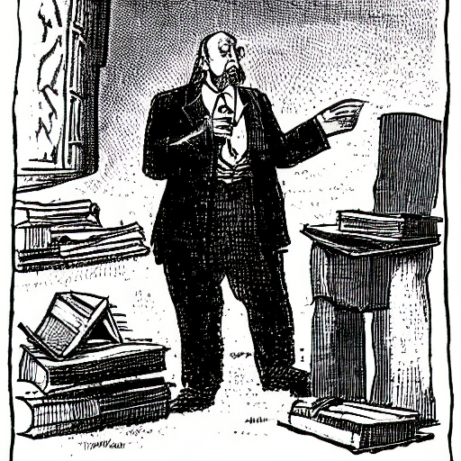
M. Krempe: “Every instant that you have
on those books is utterly and entirely lost.
have burdened your memory with exploded
and useless names. Good God! In what
land have you lived?” I replied in the
affirmative.

Slide 5
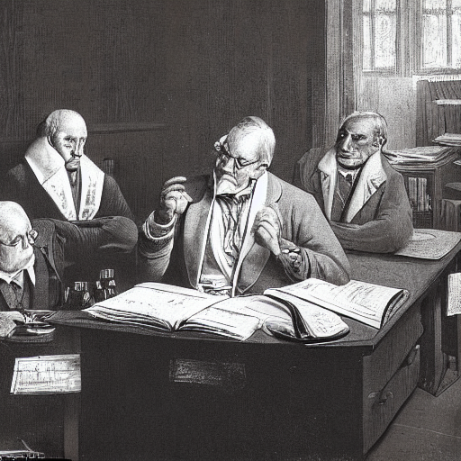
M. Waldman appeared about fifty years of age, but with an aspect expressive of the greatest
His person was short but remarkably erect and his voice the sweetest I had ever heard. He
his lecture by a recapitulation of the history of chemistry and the various improvements
by different men of learning.

Slide 6

M. Waldman’s lecture had removed my
against modern chemists. I closed not my
that night. My internal being was in a state
insurrection and turmoil. I felt that order
thence arise, but I had no power to produce
it.

Slide 7
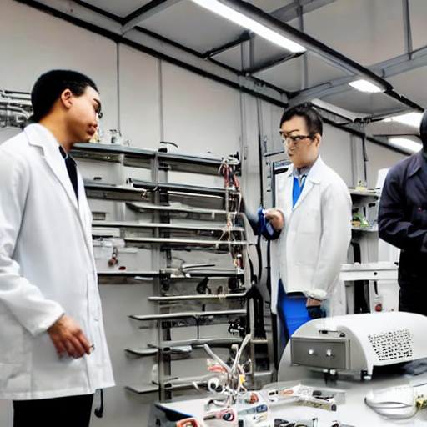
He then took me into his laboratory and
to me the uses of his various machines,
me as to what I ought to procure and
me the use of his own. He also gave me a
of books which I had requested, and I took
leave.

